Slide 1
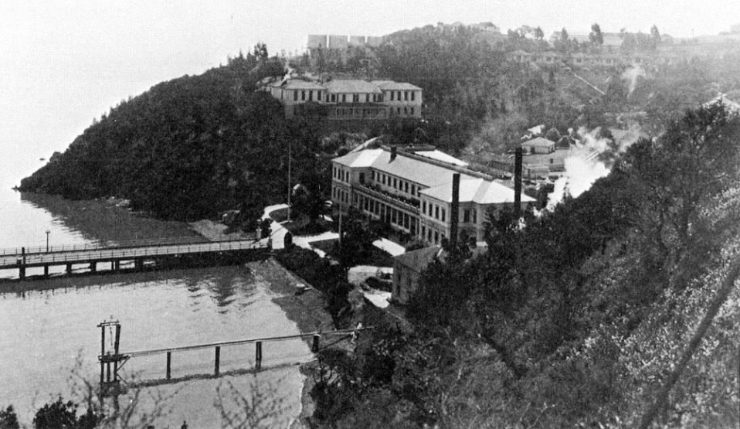
Angel Island
Twentieth Century Immigration in the West

Slide 2
Bell Work
Without talking, answer the following questions:
What are your parents' full names (First, Middle, Last)?
What is your address?
How many steps must you take to get from the sidewalk up to you front door?
What is the name of the family that lives 3 houses to your right and across the street?
What is your Mother's middle name? How do you spell it?
**YOU MUST ANSWER THEM ALL CORRECTLY!**

Slide 3
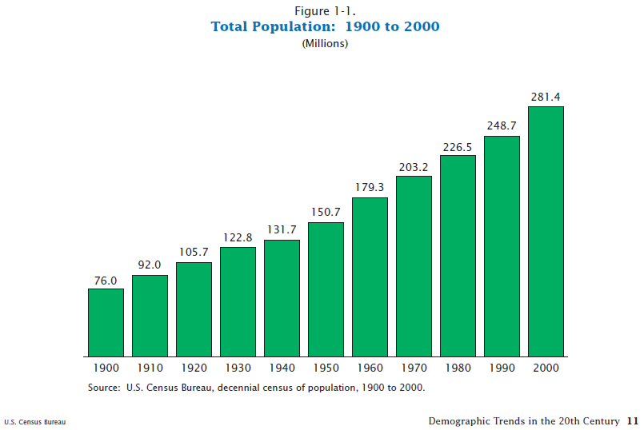
What do you think were some causes of this huge population increase since 1900?

Slide 4
Location
Angel
Island

Slide 5
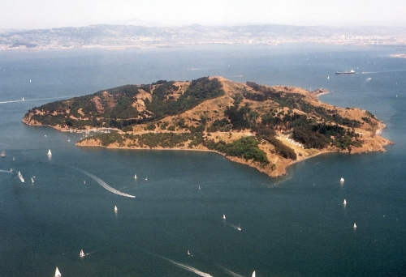
Immigration Detention Facility

Slide 6
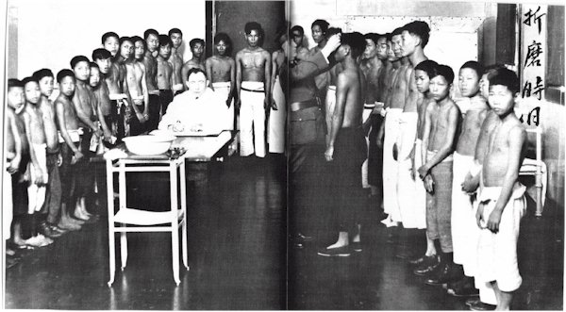
Background
Immigration Station
From 1910-1940 Angel Island was used as an immigration station to process and detain thousands of (primarily) Chinese immigrants.
The “Ellis Island of the West”
Immigrants endured harsh prison-like conditions while awaiting entry to the U.S.

